Slide 1


Oracle Application Testing Suit Project
Kick-Off
July 29th 2019

Slide 2
Agenda
Introduction
Project Scope
Execution Approach
High Level Plan & Current Status
Next Action & Support Required
Q&A

Slide 3
Introduction:
Subhasis Jana - Project Manager
Sujit Swain– Oracle application testing suite consultant
Functional Leads (IBM)
Business Process Owners (Ma’aden)

Slide 4
Project Scope:
At present no tools available in the project to automate testing of functional/technical changes for Oracle EBS.
Implementation Scope:
Setup Oracle application testing suite to fulfil the test requirements of Oracle EBS through Oracle Test Manager functionality.
Target to automate 20 Test Cases for this project.
Perform test automation by automating repeatable, reusable tests cases using tools and enabling execution.
Benefit:
OATS will help to reduce testing time and efforts and increase efficiency and productivity in testing cycle.
OATS will help to plan, organize, document, and manage the entire application testing process
Track defects and manage test requirements
Web-based test management solution

Slide 5
Oracle Test Manager Flow:
Integrated test modules provide complete test process management.
Test Requirements, Test Plan, Test Cases, Test Execution and Issues (Defects), Dashboard.
Document Test Requirement
Test Plan
Write Test Cases (Scripts)
Execute Test Cases
File Defects Found By Test execution
View Reports & Dashboard

Slide 6
Execution Approach:
Inception (Planning):
Kick-Off
On-board Project team
Finalize pre-requisite infrastructure for OATS, EBS application and Licenses
Project Plan & Tracker
Elaboration & Construction (Design & Build):
Installation and configuration of OATS
Develop functional, system test plans and schedules
Setup Oracle Applications Test Manager for Test Case Management
Develop Automated Test script as part of the Testing using OATS Tool. (upto 20 test cases per month)
Transition (Testing):
System testing
Record and report test results to Ma'aden & Complete test documentation
Conduct UAT and Sign-Off
Sign Off Criteria:
IBM to submit Implementation Completion report to Ma'aden. OATS Implementation Completion report deliverable consists of:
Test Automation Process
Test Automation Framework

Slide 7
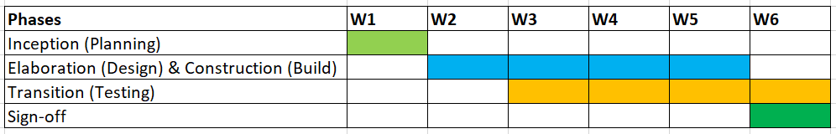
High Level Project Plan:
Overall Project Plan is for 6 weeks out of which 1 week for Planning, 4 weeks for Design & Build and 4 weeks for Testing. Project completion date is 9th Sep-2019
Planning – 29th July 2019 to 4st Aug 2019
Design and Build- 5st Aug 2019 to 2st Sept 2019
Testing – 12th Aug 2019 to 8th Sept 2019
Sign-off – 1st sept 2019 to 9th sept 2019
Go-Live – 9th Sept 2019
Deliverables:
Weekly updates to be published in weekly review meeting
Test plan and schedule
Implementation Completion Report to be submitted

Slide 8
Progress so far:
Kick Off – Planned on 29th Jul-2019
Obtain Server & OATS license – Window server will be ready in next couple of days; OATS license is available
Onboard IBM Project team to proceed with Inception phase – OATS consultant is already onboarded
Infrastructures readiness for OATS system Installation – IBM DBAs will install/configure OATS when the above windows server is ready
Identify Business Process Owners – Open item
Support Required:
Identify Business Process Owners
Validate test scenarios
Assumptions:
Windows server will be commissioned by 29th Jul-2019

Slide 9
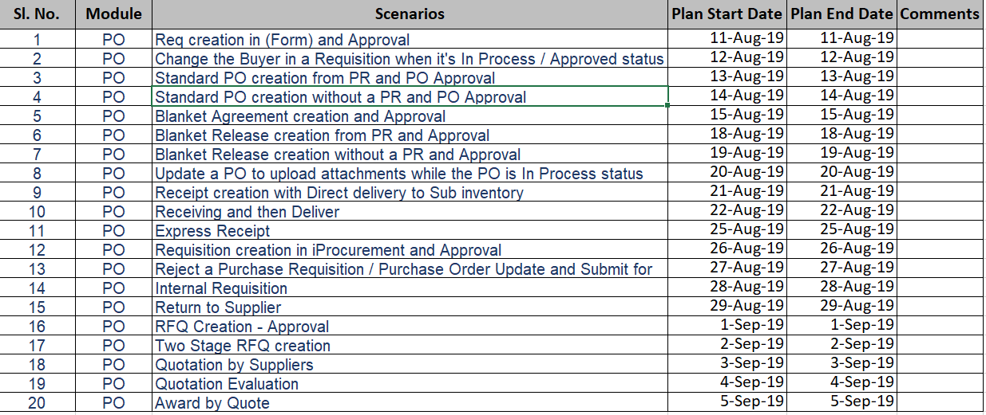
Test Scenarios (20)

Slide 10
Backup slides

Slide 11
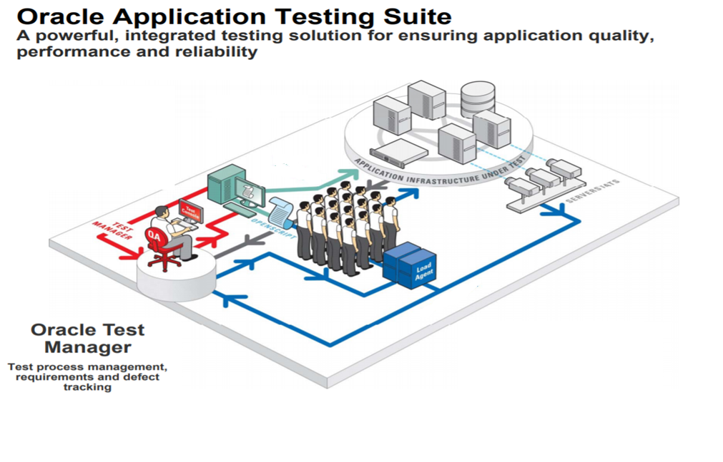

Slide 12
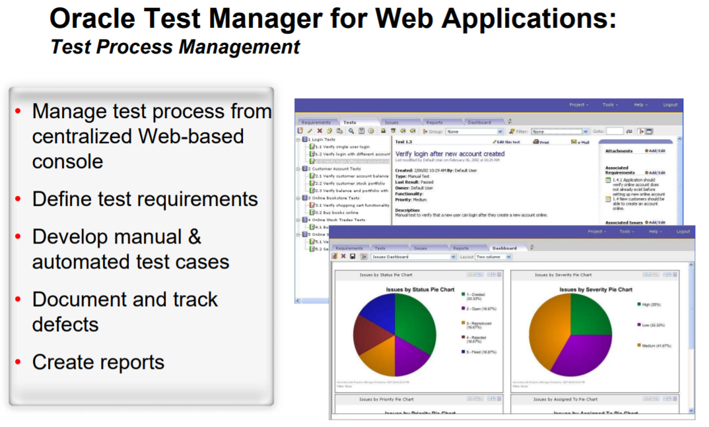

Slide 13
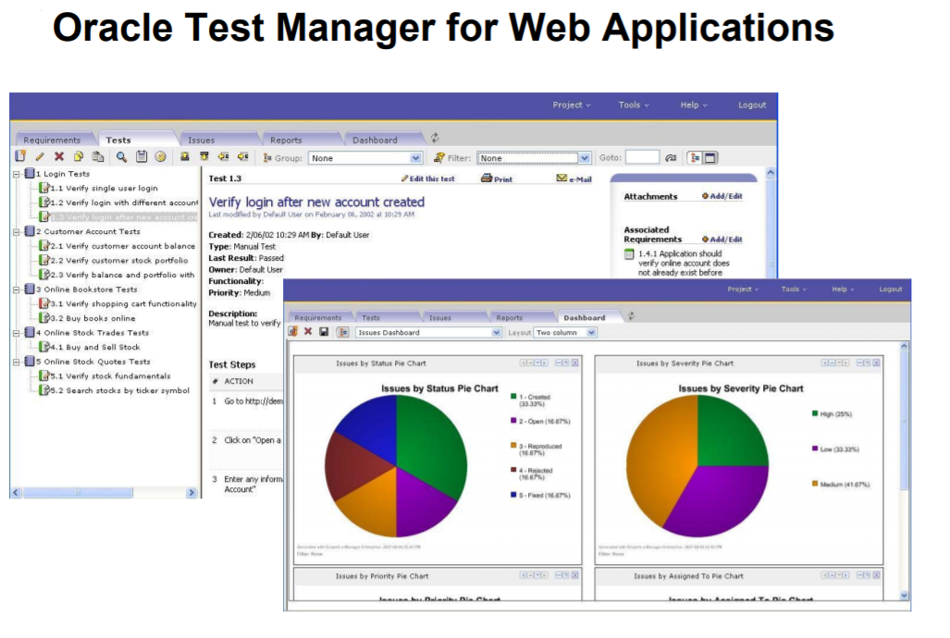

Slide 14
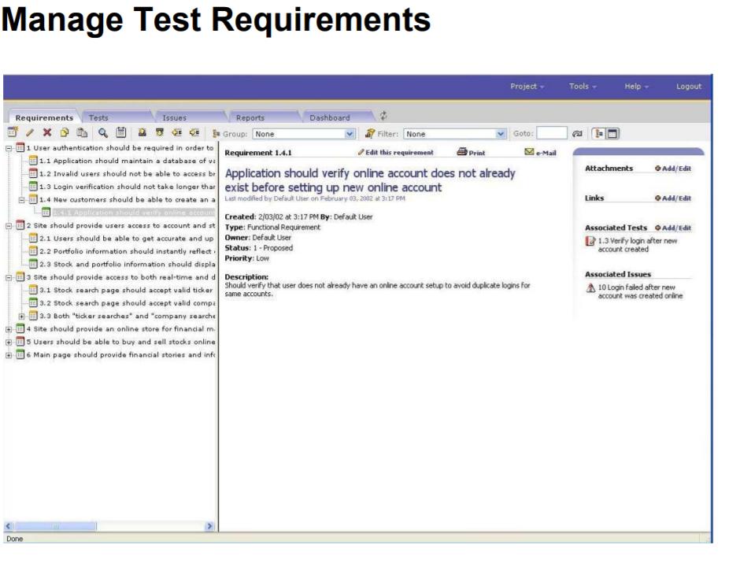

Slide 15
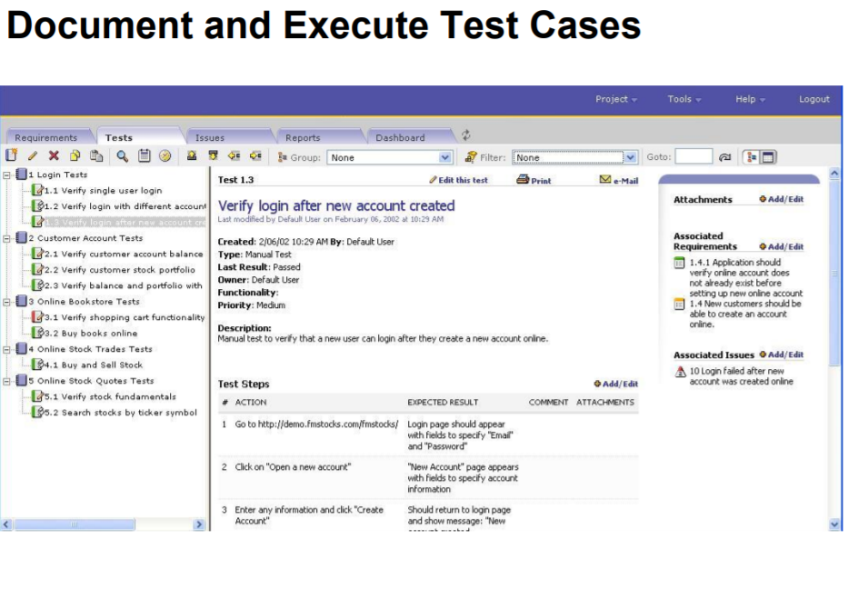

Slide 16
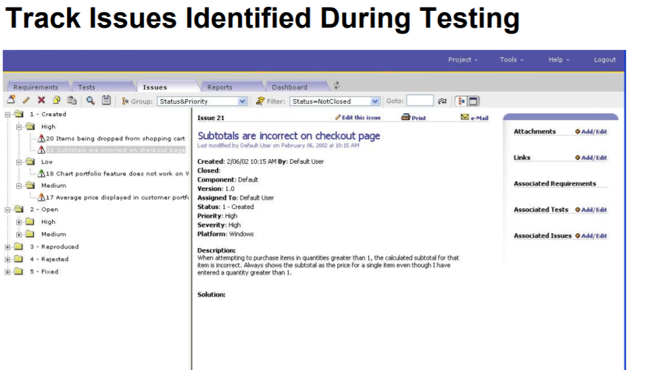

Slide 17
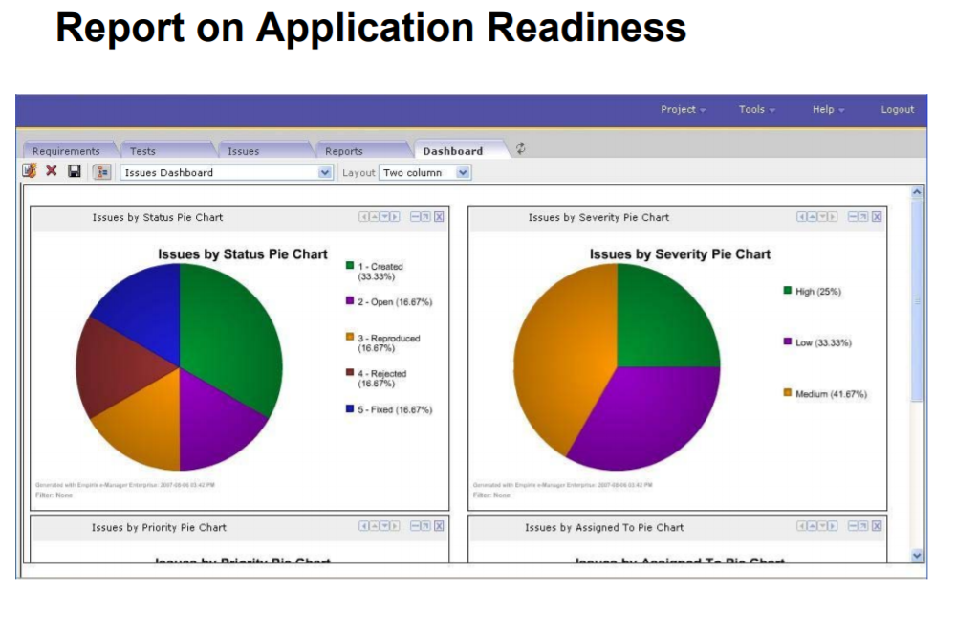

Slide 18


